Slide 1
IBM Applied Data Science Capstone
Food Trucks – Opening a New Business in Austin, Texas
By: Kevin R.
January 2021

Slide 2
Business Problem
New food truck owners in Austin, Texas do not know where to park their food truck to minimize competition
Considering Austin is one of the top food truck cities in the United States, owners will need to know this information early on if they want to succeed.

Slide 3
Data
Type of Data
Austin neighborhoods
Longitude/Latitude of neighborhoods
Food truck data
Data Sources
Wikipedia
Geopy package
FourSquare API

Slide 4
Methodology
Source Data
Scrape Wikipedia with Beautifulsoup
Remove non-necessary information
Loop neighborhood through Geopy to get coordinates
FourSquare
Loop Geopy coordinates to get venue data
Group by venue category and get mean per neighborhood
Filter by food truck
Visualization
K-Means Clustering to segment data
Clean data
Impose data onto Folium Map

Slide 5
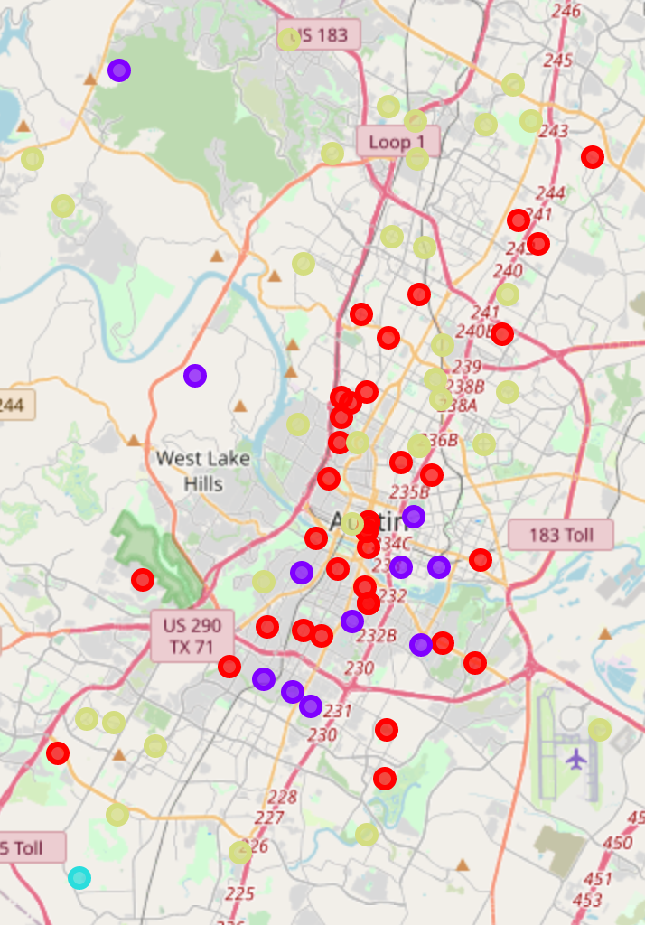
Results
Created 4 Clusters
Cluster 0: Red circles with low Food Truck count
Cluster 1: Purple circles with moderate Food Truck count
Cluster 2: Blue circle with only one Food Truck count (anomaly)
Cluster 3: Yellow circles with low Food Truck count (residential areas)

Slide 6
Recommendations and Conclusion
Open food truck in Cluster 1
There is mobility between Cluster 0 and 1, due to the nature of the business
Avoid Cluster 2 and 3
Food truck owners can now see how saturated each neighborhood is using this analysis.

